Slide 1
Health Care Organizations & Systems
PAST, Present and Future
NurS 409 Health policy, economics, & Systems

Slide 2
Objectives
Examine a variety of models for organizing health care delivery by questioning consolidation and integration with focus on virtual, horizontal, vertical & mixed integration.
Analyze the organization of care systems within various health care settings with emphasis on change through the Affordable Care Act.
Name the three components to the Triple Aim.
Readings:
Bodenheimer Ch. 16 and Ch. 5 & part of Chap. 15
Yoder- Wise Ch. 7
Explore Institute for Health Quality Website: Triple Aim
Rambur, B. A. (2017). What’s at stake in U.S. health reform: A guide to the Affordable Care Act and value-based care. Policy, Politics & Nursing Practice. 0(0) 1-11. doi: 10.1177/1527154417720935.
Wonder, A.H., Martin, E.K. & Jackson, K. (2017) Supporting and empowering direct-care nurses to promote EBP: An example of evidence-based policy development, education and practice change. Worldviews on Evidence-Based Nursing 14(4) 33-338 doi: 10.1111/wvn.12239.

Slide 3
Introduction to Health Organizations & Systems
In the field of health care today the terms organizations and systems are frequently interchanged, leading to confusion. It is important to differentiate between health Systems and health Organizations.
Health Systems tend to apply to large networks of providers that are organized within organizations that make up the Health System. For example a differentiation is made between the US and British health systems.
The US health system is a complex network of a variety of organizations ranging from teaching hospitals, for profit hospitals, independent providers, specialists etc. All deliver a variety of services from Primary, Secondary and Tertiary levels.
The British System is mainly comprised of one Organization known as the National Health Service that organizes the delivery of care and encompasses all levels of care.
For this week the focus will be primarily be on the larger system made up of organizations and how the organization contributes to the health system that it is a part of.

Slide 4
Organizations
Yoder-Wise defines Health Care Organizations as a collection of individuals brought together in a defined environment to achieve a set of predetermined objectives.
This definition appears simple, but is it?
An organization’s structure and purpose are impacted by economics, social and demographic factors. Each of the impacting factors contains hundreds of variables which lead to the development of a variety of organizational structures in the US health system.

Slide 5
Organizations
To understand organizations it is important to understand who is accessing, working in, and interacting with the organization on a regular basis.
In general health care organizations in the United States have what Bodenheimer refers to as Four Major Actors all which have a significant amount of influence on the structure of our organizations and ultimately our health system.
The Patients (Purchasers)
The Payers (Insurers/ Government)
The Providers
The Suppliers

Slide 6
Organizations
Purchasers | Insurers | Providers | Suppliers
Individuals, employers, government | Medicare, HMO, PPO etc. | Hospitals, nursing homes, home care agencies, pharmacies, physicians, mid-levels etc. | Pharmaceutical companies, Medical Supply Companies, Computer equipment Supply companies

Slide 7
Organizations
Organizational differentiation
What type of level of care is delivered?
Primary
Secondary
Tertiary
Mixture of either one or two of the levels of care

Slide 8
Organizations
Primary
Involves common health problems
Preventive Care that accounts for 80-90% of medical encounters
Secondary
Specialized Clinical expertise
Hospital care, acute care hospitals
Tertiary
Management of rare complex disorders
Combination of highly specialized care and hospital care leading to frequent access to care, long-term care facilities, and acute care facilities

Slide 9
Organizational Development
The policies and regulations that exist to govern a health system determine the number of organizational structures that will coexist within a system.
The United States has policy and regulation that allows for a variety of organizations, delivering care at a variety of levels, (primary, secondary, tertiary).
The diversity of the organizations in the United States and the free flowing movement of patients across organizations and levels of care allow for what is called a free flowing or Dispersed Model of Health Care
In Great Britain the policy and regulation has allowed for one primary organization known as National Health Services, (NHS).
The highly structured NHS aligns with the Dawson Model or Regionalized Model of Health Care. In the Regionalized model well defined roles exists for providers and hospitals outlining what type of care is delivered. The flow of patients is orderly between the levels of care.

Slide 10
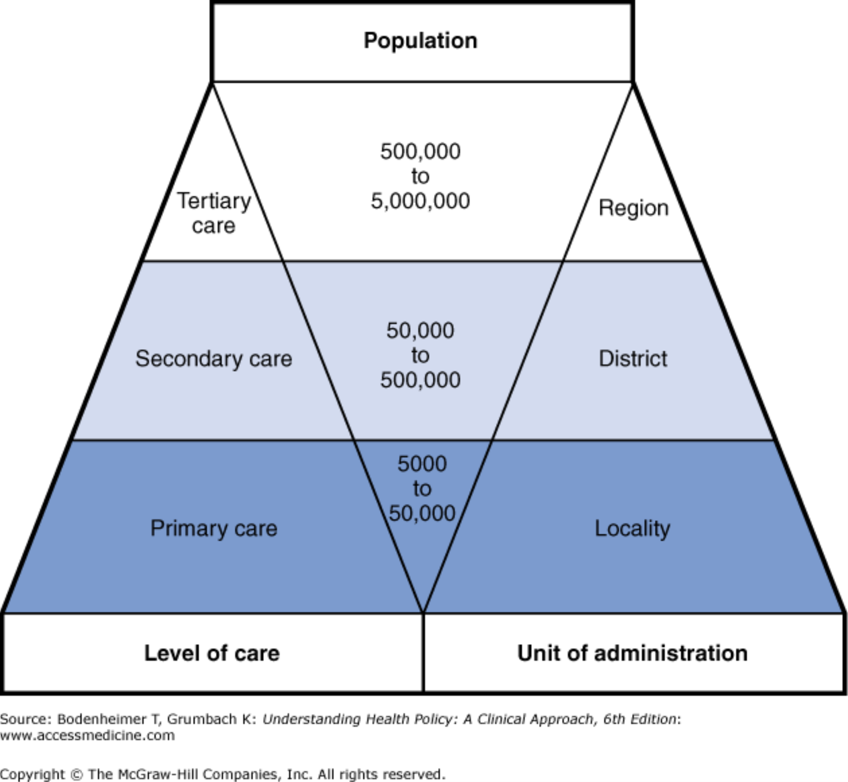
From: Chapter 5. How Health Care Is Organized—I: Primary, Secondary, and Tertiary Care
Understanding Health Policy: A Clinical Approach, 7e, 2016
Under the NHS the majority of care is delivered at the local and primary care level reflected in the base of the pyramid.
Secondary Care has fewer facilities providing this care.
Tertiary Care is the highly specialized care and this is centralized in large regions and even fewer facilities.
Legend:
Organization of services under the traditional National Health Service model in the United Kingdom. Care is organized into distinct levels corresponding to specific functions, roles, administrative units, and population bases.
Date of download: 1/12/2017
Copyright © McGraw-Hill Education. All rights reserved.

Slide 11
Organizational Development
The policies within the US has lead to a variety(mishmash) of organizations functioning within our system. It is important to recognize the differences between the organizations because of the fluidity with which our patients access all the organizations.
If a patient coming from a private hospital must access care at a teaching hospital, the patient may not be accustomed to having large numbers of students assisting in the provision of care.
This is also true for providers. Your role and expectations may change as you begin to work in different health care organizations.
The chart on the next slide identifies some of the different organizations existing in the US.

Slide 12
Organizational Development
Long-term Care | Acute Care Hospital | Public Institutions | Private non-profit | For-Profit Organizations
Ambulatory Care | Independent Providers | Veterans Administration | Public Health Department | Home Health Care
Hospice Facilities | Sub acute facilities | Nurse Owned Nurse Organized Services | Self-help Organizations

Slide 13
What Contributed to Current Organizations?
The evolution of health care organizations is complex, but taking the simple approach, it is a combination of interactions between the Four Major Actors, (purchasers, insurers, providers and suppliers).
Bodenhiemer outlines the overarching conflict between the purchasers and the healthcare industry, “The purchasers wish to reduce, and the health care industry to increase, the number of dollars spent on health care.
The provider-Insurer Pact- 1940’s-1960’s lead to increasing provider payments that were not well regulated which contributed to increasing healthcare costs for things such as operational expansion of hospitals. Costs could be passed to the employers, but because the US economy was strong little was said about increasing costs.
As hospitals and providers were able to bill and secure payment expansion, a variety of organizations developed. Organizations specializing in acute care and those services yielding the highest reimbursements from insurance companies experienced the greatest growth.
Began to see slow shift from primary to now a health care environment of secondary and tertiary care.
Insurer Pact Tension of 1970’s developed because of a downturn in the US economy. As providers continued to increase costs for services, insurers began to feel the pressure of a slipping economy so insurers attempted to offset rising costs by increasing premiums to patients.
Outrage of providers who are getting kickbacks from insurers that they are billing too high and purchasers are upset at insurers for pushing the increasing costs to them.

Slide 14
What Contributed to Current Organizations?
1990s- the purchasers started to take charge of the power in healthcare helping to decrease premiums, but this lead to free flowing access to healthcare settings. Once again a decrease in primary care and increase in specialists leading to inappropriate chronic disease management.
New Millennium: rising healthcare costs, decreasing reimbursement, purchasers continue to have high deductibles and premiums.

Slide 15
New Millennium
In the New Millennium the US health care system has seen the rise of mini sub systems that attempt to pull together the resources of multiple organizations. By pooling together resources, providers create stronger political leverage when seeking payment from insurers. In addition to the political leverage, the sub systems can track and organize the care of patients better thus optimizing the profit in the new age of payment structure.
Examples of Sub Systems Include:
Consolidated Systems
Networks

Slide 16
Organizational Relationships
The advent of sub systems such as Consolidated Systems and Networks was necessitated largely in part due to the economics of financing health care. How are providers being reimbursed?
To assure that organizations and systems are delivering quality care and not just reorganizing for financial gains the Institute for Healthcare Improvement has developed a tool called the Triple AIM at improving patient care, at the same time becoming more cost efficient at the delivery of care.

Slide 17
Organizational Relationships
Many organizations have applied the Triple AIM to the restructuring, and an emerging theme around organizations exploring multi-organizational relationships has occurred.
At this time there are two Integration models dominating the US health system. The organizational relationships attempt to organize the provision of care for patients in a manor that highlights the strengths of the participating organizations.
Horizontal Integration
Vertical Integration
Virtual Integration

Slide 18
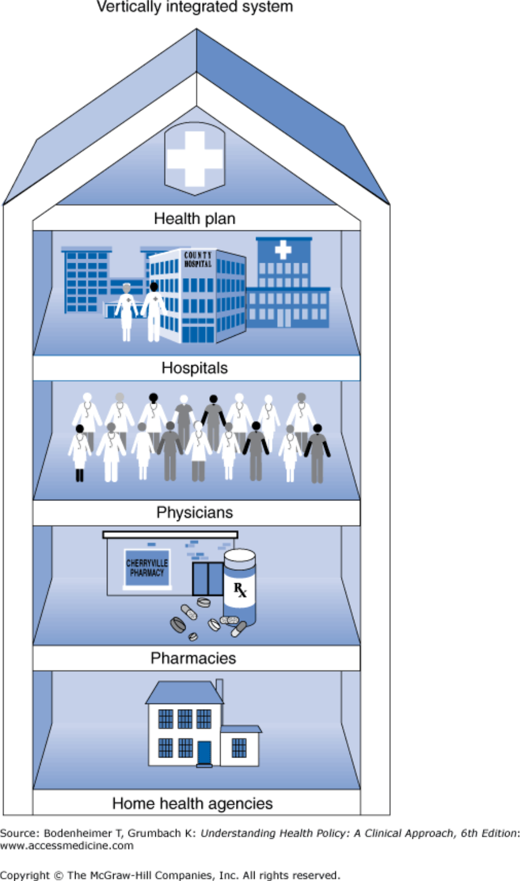
Legend:
Vertical integration consolidates (and controls) health services under one organizational roof.
Date of download: 1/13/2015
Copyright © 2015 McGraw-Hill Education. All rights reserved.

Slide 19
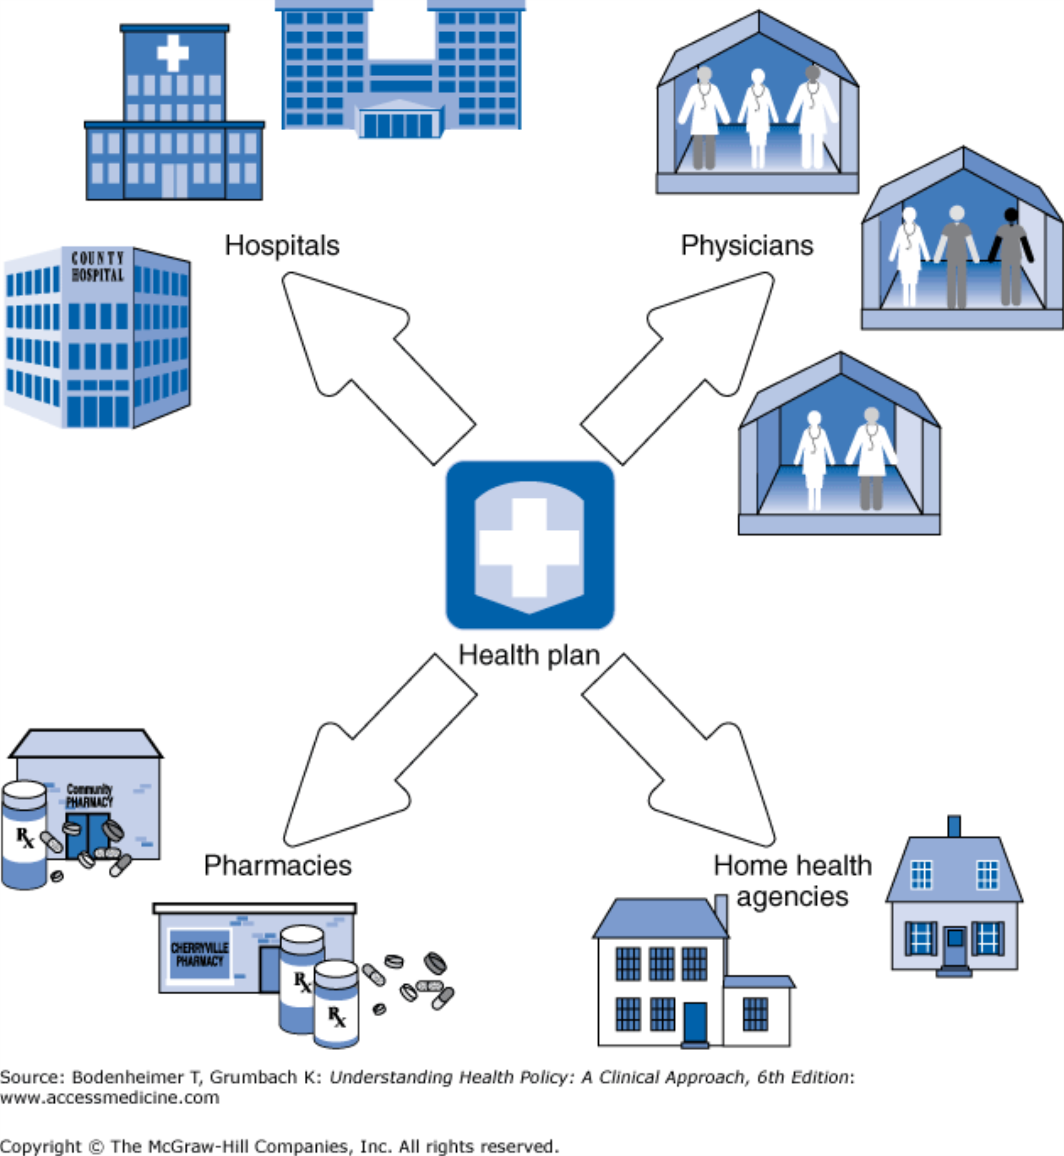
Legend:
Virtual integration involves contractual links between the health plan which may be an HMO, and physician groups, hospitals, and other provider units.
Date of download: 1/13/2015
Copyright © 2015 McGraw-Hill Education. All rights reserved.

Slide 20
Vertical Vs. Virtual
Vertical- A prominent example of a vertically integrated system would be Kaiser Health Care Organization.
The patients obtain their insurance, acute care hospital, primary care services, and pharmaceutical needs all within the organization of Kaiser.
Virtual- many consumers are familiar with this model. If they have participated in HMOs or PPO insurance programs, these are examples of virtual integration.
The network of services are all independent organizations that maintain a contract with the health plan.
The jury is still out on which produces the best health outcomes for purchasers. Both systems have positives and negatives. The Vertically integrated system provides for tighter control and communication amongst the providers on the patient condition.
Under both Integration models the goals follow the IHI Triple AIM.

Slide 21
Horizontal Systems
Organizations that provide similar services come together to provide these services throughout a larger area.
An example would be dialysis centers owned by Davita throughout a large geographic area.

Slide 22
References
Bodenheimer, T.S., & Grumbach, K. (2016). Understanding health policy: A clinical approach. (7th ed.). New York, NY: McGraw Hill.
Yoder-Wise, P. (2015). Leadership and management in nursing. (6th ed.). St. Louis, MO: Elsevier.

